Slide 1
Structuring the Article

Slide 2




Structure
January 2015
Title
Abstract
Keywords
Introduction
Literature Review
Methods
Results and Discussion
Conclusion
Acknowledgements
References
Supporting materials
Search & find
Tell your story
Provide context
Notes:
Manuscripts contain many sections and each one has a definite purpose.
At the beginning are the Title, Abstract, and Keywords. These all play important roles in allowing the article to be properly indexed and easily found by potential readers through searching. As you probably know from your own experience, these days researchers rarely browse the table of contents of a journal; rather they search for papers based on words and phrases relevant to their current project and interests. These are the advert for your paper, so ensure they are informative, attractive and effective to encourage potential readers to read your full paper.
The main text of the article includes the Introduction, Methods, Results, and Discussion. This is where you must present your work and convey the main messages and findings effectively. Readers’ time is not unlimited so make your article as concise as possible.
The last group of sections bring up the end of the manuscript. The Conclusion, Acknowledgements, References and Supporting Materials.
This should give you a feel for a typical structure but do note that some journals request a different order, for instance that the Discussion section be combined with the Conclusion or Results, while other require different or additional sections, for example some require a R & D section. You should read the guide for authors for the specific criteria of your target journal.

Slide 3
Effective manuscript Titles
Should identify the main issue of the paper
Should be concise
But also accurate, unambiguous, specific, and complete
Should use professional language and avoid rarely-used abbreviations
Will attract readers - short, catchy titles are often better cited
Notes:
Let's look in detail at each section and what it contains, starting with Title.
Effective titles have a number of characteristics. Namely, they:
Should identify the main issue of the paper
Should be concise
But also accurate, unambiguous, specific, and complete because you want the appropriate audience to read your paper; if the title isn’t accurate, the right people may not find or read it and the community would remain unaware of your work, leading to lower citations than the paper deserves.
Should use professional language and avoid rarely-used abbreviations
Will attract readers - short, catchy titles are often better cited
Which means, the best titles contain the fewest possible words that adequately and accurately describe the content of a paper.
Naturally, the title should be discussed and agreed with your co-authors.

Slide 4
Abstract
Keep it as brief as possible
Summarize the problem, methods, results, and conclusions
Make sure it is clearly written and easy to understand
Make sure it is accurate and specific while also being catchy
accurately reflects the content of the paper
Follow the Rule of 10
1-2 sentences: aim
2-3 sentences: materials & methods
2-3 sentences: results
2 sentences: discussion/conclusions
Notes:
If the title catches a reader’s attention, the next thing a potential reader will look at is the Abstract which is always freely available in electronic abstracting and indexing services, such as Web of Science, PubMed, Medline, Embase, and Scopus.
The Abstract should be as brief as possible - a single paragraph is sufficient.
The Abstract should summarize the problem, the methods, the results, and the conclusions.
Consider your writing style - an abstract that is clearly written and easy to understand will strongly encourage the reader to read the rest of your paper.
Think of the abstract as the advertisement for your article since it is freely available via online searching and indexing – make sure it is accurate and specific but also catchy.
Take the time to write the Abstract very carefully. Many authors write the Abstract last so that it accurately reflects the content of the paper.

Slide 5
Keywords
Are the labels of the manuscript
Are used by indexing and abstracting services
Should be specific
Should use only established abbreviations (e.g. DNA)
Article title | Keywords
Enhancing EFL Students’ Autonomous Learning of English Conversation During COVID-19 Via Language-in-talk Log Assignments | Asian EFL Learners, Autonomous Learning, COVID-19, English Language Teaching, Learning Logs, Online Learning
Check the Guide for Authors for any specific guidance on keywords.
Notes:
Next comes the Keywords which are the labels or tags for your manuscript, used by indexing and abstracting services.
The table on this slide contains a good examples of keywords that are associated with an article. As you can see:
First, keywords should be specific enough to give someone a very quick idea about the content of your paper but not so specific that no one would be searching for the word. To help you with this you should search the author keywords of articles relevant to your manuscript and see how many results are returned e.g. “nanomaterials” which returns 33,000 results is too general, while “nanosimluation” which returns only 5 results is too narrow.
Second, you should limit repetition with words already in the title as much as possible.
Third, you should use only abbreviations that are firmly established in the field of study, e.g. DNA.
Some journals have special requirements for keywords, such as providing authors with a list to select from, so check the guide for authors to see if that is the case for your journal of interest.

Slide 6
Introduction
Explain the problem
Describe your approach
Why is it important? What is novel compared to what is already available in the literature?
Mention existing solutions and limitations
.Are there any existing solutions? If so, what is the best solution and what are its limitations?
How does your proposed study aim to progress on this? What makes yours different or better?
Notes:
Moving into the main part of the article, the Introduction, Methods, Results and Discussion.
The Introduction is used to provide a brief context for your manuscript and convince readers why your work advances a field of study.
1. A good introduction should start with the why - explain what the problem is that you are trying to solve to give a clear motivation for the work.
2. You can then move into the how and give a High level description of your approach. Why is it important? Why is it difficult? What is novel compared to what is already available in the literature?
3. Next, identify existing solutions and limitations: Are there any existing solutions? If so, what is the best solution and what are its limitations and how does your proposed study aim to progress on this? What makes yours different or better?
A couple of paragraphs is usually sufficient for a regular article while introductions of letters can be shorter, sometimes only one paragraph. This section shouldn’t be a history lesson, you can’t summarise the whole field, but you should introduce the main scientific publications on which your work is based. Cite a couple of original and important works, including recent review articles, to give the reader a sense of how your work fits into the literature. However, take care to not make citations to irrelevant references, including your own.
Although it can be tempting to re-use introductions from your previous papers on similar studies, every paper should present a new result and the work should be specifically motivated. This requires a unique introduction every time.

Slide 7
Methods
Describe how the problem was studied
Explain the methodology
Identify the instruments/equipment and materials used
Identify participants
Notes:
The Methods section comes next and describes how you studied the problem.
It is important to be detailed, to the extent that a knowledgeable reader would be able to reproduce the experiment. Diagrammatic summaries or embedded video demonstrations may be helpful.
Any previously published procedures should not be re-written in detail but should be mentioned in the methods or described in the Supporting Materials sections, and correctly referenced; modifications should be noted.
The equipment and materials used in experiments should be identified, along with their sources and related product information (company, molec. weight, purity, etc.) if there is the chance for variability of quality of these items.
If the work is computational or theoretical, then the code, computational, or analytical methods should be described.
Write out full chemical/biological compound names (followed by abbr.) then use abbreviations throughout paper and make sure that all symbols are defined.
Present proper control experiments

Slide 8
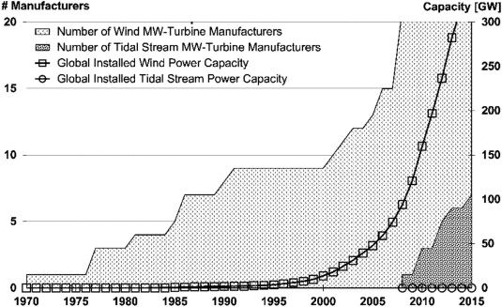
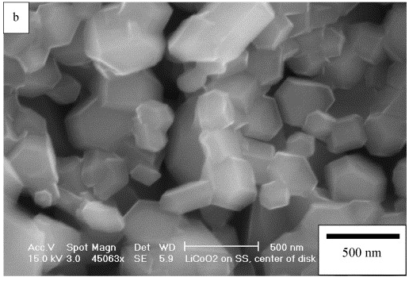
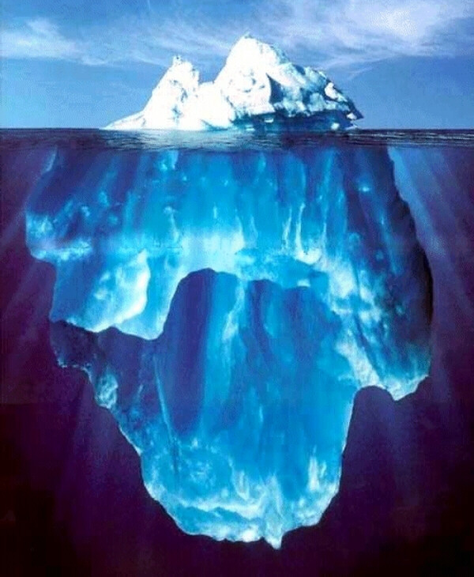
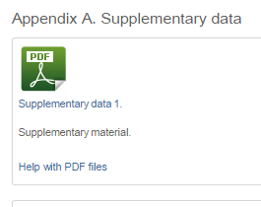
Results
Include only data of primary importance i.e. the main and unexpected findings (use supplementary data for data of secondary importance)
Use sub-headings to keep results of the same type together and avoid redundancy
Use figures and tables for efficiency and clarity
Provide factual analyses
Notes:
The Results section follows, and contains an analytical description of data with minimal interpretation of results and/or comparison with literature.
When writing your results section:
You should include only data of primary importance in the results, and include additional supporting results in the supplementary data section or in a data repository to which you can link from your article. You should be careful not to hold back data in the hopes of publishing it as a separate paper later, as this way you could lose important data that gives additional weight to your main results.
You should consider use sub-headings to keep results of the same type together. These also help with organising your paper as you can then easily refer back to the relevant section when writing your discussion to avoid duplicating text.
Use figures and tables to make the data as clear and easy to understand as possible. In fact, many readers head straight for the figures when they start reading the main part of the paper.
You should provide statistical analyses to show the certainty on your results.
I’ll now give you a few tips for visualisations and tables.

Slide 9
Results - visualisations
The caption and legend should be self-explanatory to enable the figure to stand alone.
Use colour ONLY when necessary
Graphs: un-crowded plots; restrict data sets (symbols to distinguish); well-selected scales; axis labels; label size.
Photos: scale marker; do not manipulate the image to enhance the results.
Notes:
Some general guidance to start:
First, the caption and legend of a figure should be brief and it should contain sufficient explanatory details to explain the figure without the need to refer to the text. Readers often review the figures before they read the entire paper.
Second, it can be tempting to go crazy with colour, but it should be used sparingly and only when absolutely necessary. For instance, if different line styles can clarify the meaning, don’t use colors or other thrilling effects that can distract from the content and may not appear when printed in black and white.
Now some advice on specific types of figures:
Firstly graphs. These are often used to compare experimental results with those of previous works, or with calculated/theoretical values. Graphs should not be crowded with many data sets; try to present at most 3 to 4 data sets per figure. Use well-selected scales with broken axes if needed, label the axes clearly, and use different symbols or line styles so that one can quickly discriminate between the data sets, even in greyscale.
Secondly photographs. These should include a scale marker and the resolution should be clear. You must never manipulate the image to enhance the results – what is portrayed in the paper should remain genuine and authentic.

Slide 10
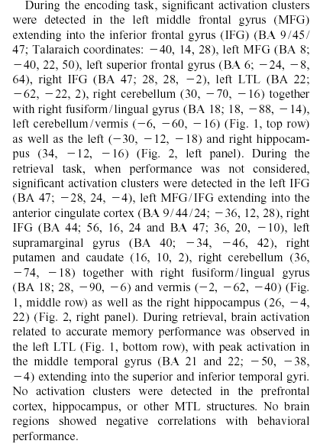
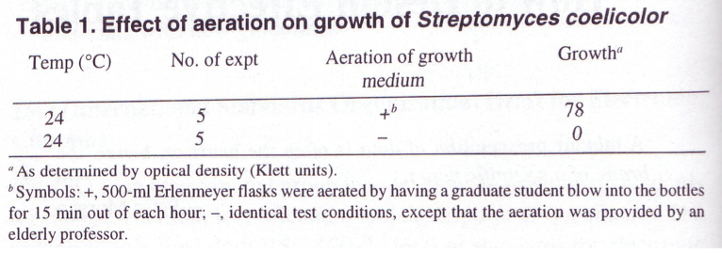
Results - tables
Needs a table
Does not need a table
Growth medium aeration was essential for the growth of S. coelicolor. At room temperature (24°C) in stationary cultures, bacterial growth was not measurable, whereas in aerated cultures, substantial growth was evident (78 Klett units).
Notes:
Now moving onto tables which are used to give actual experimental results. Think carefully about when a table is appropriate and when it isn’t. I have taken a couple of examples from “Writing the biomedical manuscript.” by C. Dant that illustrate this well. Looking to the example on the left where strings of results presented have been presented in a paragraph of text, much better would have been to include a table. Conversely, on the right here you can see a table included that is not necessary – a brief couple of sentences would have been more than sufficient.
Extremely long tables of raw data should not be included in the main article unless absolutely necessary; better would be to include them in the supplementary data section or to post them in a data repository and link to that from the article.

Slide 11
Discussion
Interpretation of results
Most important section
Make the discussion correspond to the results and complement them
Compare published results with your own
Avoid:
Statements that go beyond what the results can support
Non-specific expressions
New terms not already defined or mentioned in your paper
Speculations on possible interpretations that are not rooted in facts
Notes:
The discussion section completes the main part of the paper. The discussion is where you interpret what your results mean and really sell your data. It is arguably the most important section of your paper, and from conversations with our editors we know that a huge number of manuscripts are rejected because the discussion is weak or only includes a mere description of the results.
You should make sure that the discussion corresponds to and complements the results. You should not simply repeat the results here and the sub-sections I mentioned earlier should help to enable this cross referencing and avoid you needing to repeat what you have said before under the results section.
The best discussions go further than the results of the study in question, and compare other previously published results. Critically you should not ignore work in disagreement with yours – confront it and convince the reader why your results are correct or better.
You should be careful:
- To avoid statements that go beyond what your results can support
- To avoid non-specific expressions such as “higher temperature” or “at a lower rate”; use quantitative descriptions instead such as: the temperature increased by x degrees Fahrenheit; following exercise the rate of burn increased to y kcal/min.
- To avoid new terms not already defined or mentioned in your paper
At this stage you may realise that you are not able to support your story because some critical items have not been studied substantially, and if so you will need to perform further experiments.

Slide 12
Conclusion
Explain how your work advances the present state of knowledge
Do not repeat results or the abstract
Discuss uses, extensions, or applications
Suggest future experiments
Notes:
Now to the final sections. In the conclusion you should clearly explain how your work advances the field of study.
You should take care not to simply repeat the experimental results. You should rather indicate uses, extensions, or applications of the work but do not overreach, hence statements such as “this method can potentially be used…” do not belong to the conclusions.
You can suggest future experiments that build on your work and point out any relevant experiments that may already be underway.
The conclusions should also be distinct from the abstract as they serve a different purpose, although some of the same messages may be included.
The conclusion should be clear to help the reviewers and editors judge your work and its impact.

Slide 13
Acknowledgements
Advisors
Financial supporters and funders
Proof readers and typists
Suppliers who may have donated materials
Notes:
The Acknowledgements section is where you can acknowledge the names of the important people or entities who have helped you, but who do not fulfil the criteria for authorship which we will cover later in the ethics section. Examples include: advisors, financial supporters, proof readers and suppliers.

Slide 14
References
Always ensure you have fully absorbed the material you are referencing
Avoid excessive self citations or citations to publications from the same region or institute
Conform to any requirements outlined in the Guide for Authors
Notes:
Finally – references. The reference list is where you cite the main scientific publications your work is based on.
Some tips to help you:
Do not include too many references, especially if they are only tangentially related to your work.
Always ensure that you have fully absorbed and understood the material you are referencing. Do not just rely on reading just the abstract, excerpts, mentions in other papers, or isolated sentences. Know what you’re referencing!
Avoid excessive self-citations of your own work or from a single region or institute to ensure that you are demonstrating your understanding of the full, broad, and international literature, including from research groups with whom you disagree, where applicable.
Check the Guide for Authors to ensure the proper format or requirements in terms of the maximum number of references that may be included.
Consider using a reference manager, such as Mendeley, to build up your reference list simply and with consistent formatting to the journal’s required style, if applicable.

Slide 15

The process of writing – building the article
Title, Abstract, and Keywords
Conclusion
Introduction
Methods
Results
Discussion
Figures/Tables (your data)
Notes:
For most scientific fields, the most efficient way is to regard the manuscript as a wall and build it brick by brick. I would suggest that you follow a different sequence for writing the article than you do for reading it.
Start with producing your tables and figures, with captions/legends since the data is central to the paper.
Then describe the Methods used, the Results found, and the Discussion around these results.
The Conclusion should flow on from this fairly easily.
Then you write the Introduction, explaining where your work fits into the field as a whole.
Finally, you write the Title, Abstract and Keywords so they are fully appropriate to the final content.
This process of building the article is easier, more logical, and more effective that trying to write an article in the sequence it is read.

